Slide 1
Sales Financial Analysis Dashboard
Interactive Tableau Dashboard Project
Task 3: Dashboard Design
Dataset: Sales_Financial_Dataset
Tool: Tableau Public
Submitted by: Mansi Hasija
Date:15 August 2026

Slide 2
Key KPIs
Dashboard 1 – Sales Performance Dashboard
Total Sales
Total Profit
Total Quantity
Sales Growth
52,198
13,497
104
-38.4%
The KPIs shown are for the selected Year-Month: 2025-03.
Sales, profit and quantity provide a quick view of period performance.
Sales Growth indicates the month-over-month performance change.
2

Slide 3
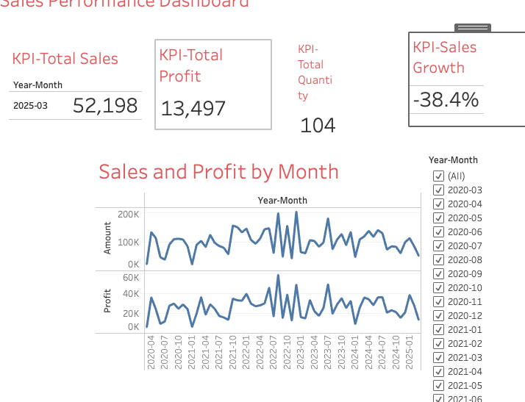
Dashboard 1 – Observations
Sales Performance Dashboard
The dashboard combines KPI cards with a Sales and Profit by Month time series.
The Year-Month filter provides interactive period selection.
For 2025-03, sales are 52,198, profit is 13,497 and quantity is 104.
Sales Growth is -38.4%, indicating a decline versus the previous month.
3

Slide 4
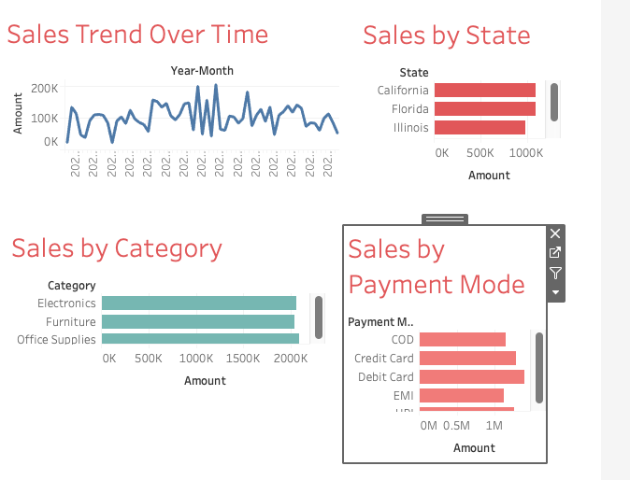
Dashboard 2 – Observations
Sales Analysis Dashboard
Sales fluctuate substantially across the time series.
State-level sales differ, with New York among the stronger contributors.
The three product categories contribute at broadly similar levels.
Debit Card is the strongest payment mode in the displayed analysis.
4

Slide 5
Key Business Insights
Monitor month-to-month sales fluctuations to identify periods of strong and weak performance.
Use state-level comparisons to identify stronger markets and locations requiring attention.
Category-level sales are relatively balanced, so performance should be monitored across all major categories.
Payment-mode analysis can help understand transaction preferences and support payment strategy decisions.
Interactive filtering allows stakeholders to investigate performance for specific periods.
5

Slide 6
Conclusion
The Tableau dashboards provide an interactive view of sales and financial performance.
KPI cards summarize sales, profit, quantity and growth for quick decision-making.
Time-series, category, state and payment-mode views provide complementary perspectives on performance.
The dashboards can help business stakeholders identify trends, compare performance and focus on areas requiring attention.
Thank You
6

